Slide 1
INFO-3142
Dictionaries

Slide 2
Dictionaries Compared to Lists
Values in lists are accessed by means of integers called indices, which indicate where in the list a given value is found
Dictionaries access values by means of integers, strings, or other Python objects called keys, which indicate where in the dictionary a given value is found
Both lists and dictionaries provide indexed access to arbitrary values, but the set of items that can be used as dictionary indices is much larger than, and contains, the set of items that can be used as list indices
Both lists and dictionaries can store objects of any type

Slide 3
Dictionaries Compared to Lists
Values stored in a list are implicitly ordered by their positions in the list, because the indices that access these values are consecutive integers
Values stored in a dictionary are not implicitly ordered relative to one another because dictionary keys aren’t just numbers
Note that if you’re using a dictionary but also care about the order of the items (the order in which they were added, that is), you can use an ordered dictionary:
A dictionary subclass that can be imported from the collections module
You can also define an order on the items in a dictionary by using another data structure (often a list) to store such an ordering explicitly; this won’t change the fact that basic dictionaries have no implicit (built-in) ordering

Slide 4
Dictionaries Compared to Lists
x = []
y = {}
y[0] = 'Hello'
y[1] = 'Goodbye'
#x[0] = 'Hello'
#Traceback (innermost last):
# File "<stdin>", line 1, in ?
#IndexError: list assignment index out of range
print(y[0])
#Hello
print(y[1] + ", Friend.")
#'Goodbye, Friend.'

Slide 5
Dictionaries Compared to Lists
y["two"] = 2
y["pi"] = 3.14
print(y["two"] * y["pi"])
#6.28
english_to_french = {}
english_to_french['red'] = 'rouge'
english_to_french['blue'] = 'bleu'
english_to_french['green'] = 'vert'
print("red is", english_to_french['red'])
#red is rouge

Slide 6
Other Dictionary Operations
english_to_french = {'red': 'rouge', 'blue': 'bleu', 'green': 'vert'}
print(len(english_to_french))
#3
print(list(english_to_french.keys()))
#['green', 'blue', 'red']
print(list(english_to_french.values()))
#['vert', 'bleu', 'rouge']
print(list(english_to_french.items()))
#[('green', 'vert'), ('blue', 'bleu'), ('red', 'rouge')]

Slide 7
Other Dictionary Operations
print(list(english_to_french.items()))
#[('green', 'vert'), ('blue', 'bleu'), ('red', 'rouge')]
del english_to_french['green']
print(list(english_to_french.items()))
#[('blue', 'bleu'), ('red', 'rouge')]
print('red' in english_to_french)
#True
print('orange' in english_to_french)
#False

Slide 8
Other Dictionary Operations
print(english_to_french.get('blue', 'No translation'))
#bleu
print(english_to_french.get('chartreuse', 'No translation'))
#No translation
print(english_to_french.setdefault('chartreuse', 'No translation'))
#No translation

Slide 9
Other Dictionary Operations
x = {0: 'zero', 1: 'one'}
y = x.copy()
print(y)
#{0: 'zero', 1: 'one'}
z = {1: 'One', 2: 'Two'}
x = {0: 'zero', 1: 'one'}
x.update(z)
print(x)
#{0: 'zero', 1: 'One', 2: 'Two'}

Slide 10
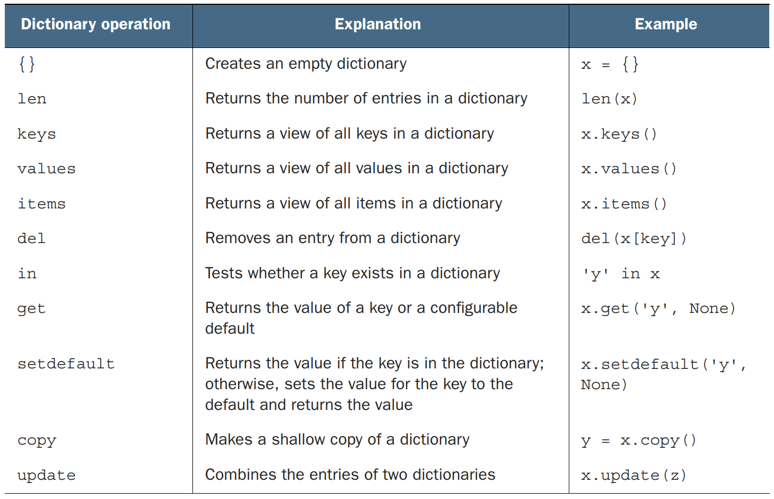
Dictionary Operations

Slide 11
Word Counting
sample_string = "To be or not to be"
occurrences = {}
for word in sample_string.split():
occurrences[word] = occurrences.get(word, 0) + 1
for word in occurrences:
print("The word", word, "occurs", occurrences[word], "times in the string")
#The word To occurs 1 times in the string
#The word be occurs 2 times in the string
#The word or occurs 1 times in the string
#The word not occurs 1 times in the string
#The word to occurs 1 times in the string

Slide 12
What can be used as a Key
Python permits more than just strings to be used as keys
Any Python object that is immutable and hashable can be used as a key to a dictionary
Lists are mutable because list elements can be added, changed, or removed
Dictionaries are also mutable for the same reason
The requirement that keys be immutable and hashable means that lists can’t be used as dictionary keys, but in many instances, it would be convenient to have a list-like key
Python solves this difficulty by providing tuples, which are basically immutable lists

Slide 13
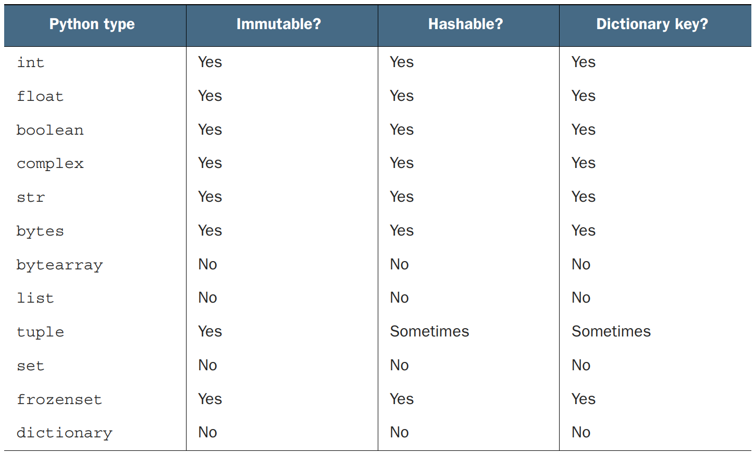
What can be used as a Key

Slide 14
Sparse Matrices
rownum = 0 # these two variables need to be defined
colnum = 0
matrix = [[3, 0, -2, 11], [0, 9, 0, 0], [0, 7, 0, 0], [0, 0, 0, -5]]
matrix = {(0, 0): 3, (0, 2): -2, (0, 3): 11,
(1, 1): 9, (2, 1): 7, (3, 3): -5}
if (rownum, colnum) in matrix:
element = matrix[(rownum, colnum)]
else:
element = 0

Slide 15
Dictionaries as Caches
def sole(m, n, t):
# . . . do some time-consuming calculations . . .
return(result)
sole_cache = {}
def sole(m, n, t):
if (m, n, t) in sole_cache:
return sole_cache[(m, n, t)]
else:
# . . . do some time-consuming calculations . . .
sole_cache[(m, n, t)] = result
return result

Slide 16
Efficiency of Dictionaries
If you come from a traditional compiled-language background, you may hesitate to use dictionaries, worrying that they’re less efficient than lists (arrays)
The truth is that the Python dictionary implementation is quite fast
Many of the internal language features rely on dictionaries, and a lot of work has gone into making them efficient
Because all of Python’s data structures are heavily optimized, you shouldn’t spend much time worrying about which is faster or more efficient
If the problem can be solved more easily and cleanly by using a dictionary than by using a list, do it that way, and consider alternatives only if it’s clear that dictionaries are causing an unacceptable slowdown

